Slide 1

Microsoft Reactor Get Started with Windows Subsystem for Linux
Event Code: #13071

Slide 2
FAQ’s
What are the Reactors?
Reactors are community spaces where technology professionals meet, learn, and connect—to both their local peers as well as industry-leading ideas and technology from Microsoft, partners, and the open source community.
With a diverse mix of hands-on workshops, expert panels, and community events, there’s something for everyone— whether you’re just getting started or working on complex projects.
Reactor programming is always free and inclusive of a broad set of products, tools, and technologies. You will find:
First party content designed to help developers learn new skills in high-demand fields such as Machine Learning, AI, and Data Science
New content around breakthrough technologies and concepts such as quantum computing and blockchain
Resources, talks and classes from Microsoft for Startups to deliver what startups need to succeed
Cloud Advocates who deep-dive into their technical specialties and the Industry Experiences team to provide tailored content around applications for Manufacturing, Healthcare, Retail, and other verticals
Reactors always welcome community groups, Meetups, partners and MVPs to use our space

Slide 3
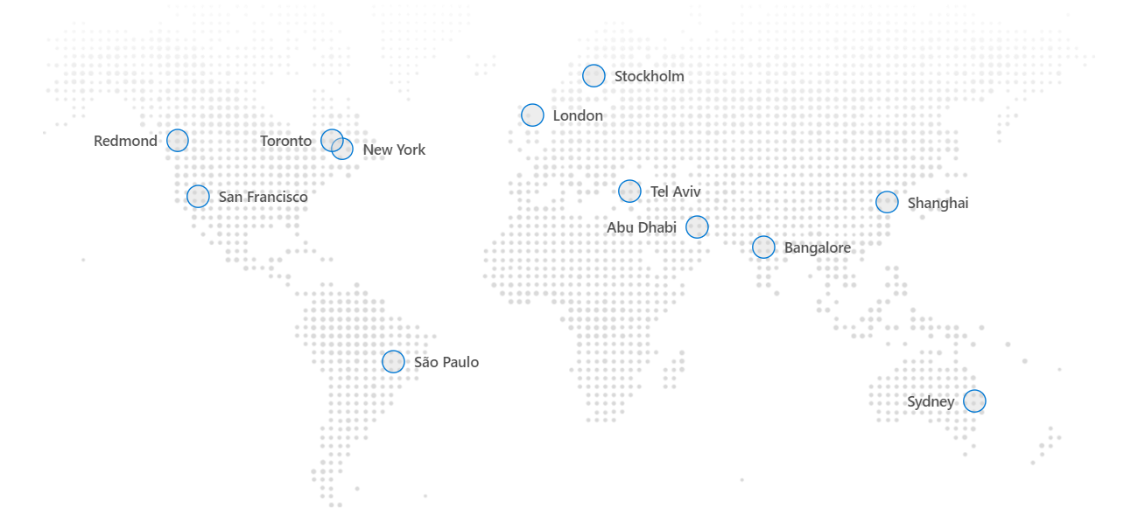
Map

Slide 4
Our Code of Conduct
Be welcoming and respectful
Be open to all questions and viewpoints
Be understanding of differences
Be kind and considerate to others
Be aware of others
Be friendly and patient
Microsoft is dedicated to empowering every person and every organization on the planet to achieve more. This includes Microsoft Reactor events where we seek to provide a respectful, friendly, professional experience for everyone, regardless of gender, sexual orientation, physical appearance, disability, age, race or religion. We do not tolerate any behaviour that is harassing or degrading to any individual, in any form. Individuals are responsible for knowing and abiding by these standards. We encourage everyone to assist in creating a welcoming and safe environment.

Slide 5
Our Code of Conduct
Microsoft is dedicated to empowering every person and every organization on the planet to achieve more. This includes Microsoft Reactor events where we seek to provide a respectful, friendly, professional experience for everyone, regardless of gender, sexual orientation, physical appearance, disability, age, race or religion. We do not tolerate any behaviour that is harassing or degrading to any individual, in any form. Individuals are responsible for knowing and abiding by these standards. We encourage everyone to assist in creating a welcoming and safe environment.

Slide 6
Our Ask of You
Be welcoming and respectful
Be open to all questions and viewpoints
Be understanding of differences
Be kind and considerate to others
Be aware of others
Be friendly and patient

Slide 7
Get Started with Windows Subsystem for Linux

Slide 8

Allen Sanders
Principal Cloud Architect
Speaker Bio: Allen Sanders is a Principal Cloud Architect with over 25 years of experience in software engineering, architecture and design delivering technology strategy and business solutions in multiple verticals. As a Microsoft Certified Professional, he has taught, led and mentored teams of varying sizes in multiple application transformation efforts. He has a passion for learning – both his own and for others.

Slide 9
Agenda
Introduction
Knowledge Check
Installing a Linux Distribution
Summary
Windows & Linux File System Integration
Adding Node.js
WSL & Visual Studio Code

Slide 10
Introduction

Slide 11

What is WSL?
Feature that can be enabled on modern versions of Windows
With WSL 2, able to run full Linux natively using Hyper-V
Provides a GNU/Linux terminal for launching Linux commands

Slide 12

What is WSL?
Enables navigation between the Windows & Linux file systems
Supports use of modern dev tools (e.g., Python, Node.js, .NET Core)
Provides powerful capabilities of both platforms on single machine

Slide 13
Installing a Linux Distribution
https://aka.ms/WindowsSSLinux-8

Slide 14
Installing WSL
Use PowerShell to enable this optional feature (requires restart)
Once enabled, download and install distribution from Microsoft Store
Multiple Linux distributions supported

Slide 15

Installing WSL
On first run of distribution, you’ll create an account name & password
Also, good idea to update the distribution (on start and ongoing)
In addition, supports installation of custom distributions

Slide 16
Windows & Linux File System Integration

Slide 17
Crossing Over
Continue to have access to Windows commands in command prompt
Now also have access to Linux commands through WSL
Windows binaries can be called from Linux and vice versa using WSL

Slide 18
Crossing Over
Within the Linux shell, can access Windows file system using /mnt/c
From Windows explorer, can access Linux file system using \\wsl$ share
Can optionally map network drive from Windows to Linux file system

Slide 19
Adding Node.js

Slide 20
Installing Node.js et al
Use cURL to pull latest version of Node.js & npm
Use apt-get install to install
Use npm to install Express for HTTP request handling
node --version, npm --version, and express --version used to confirm

Slide 21
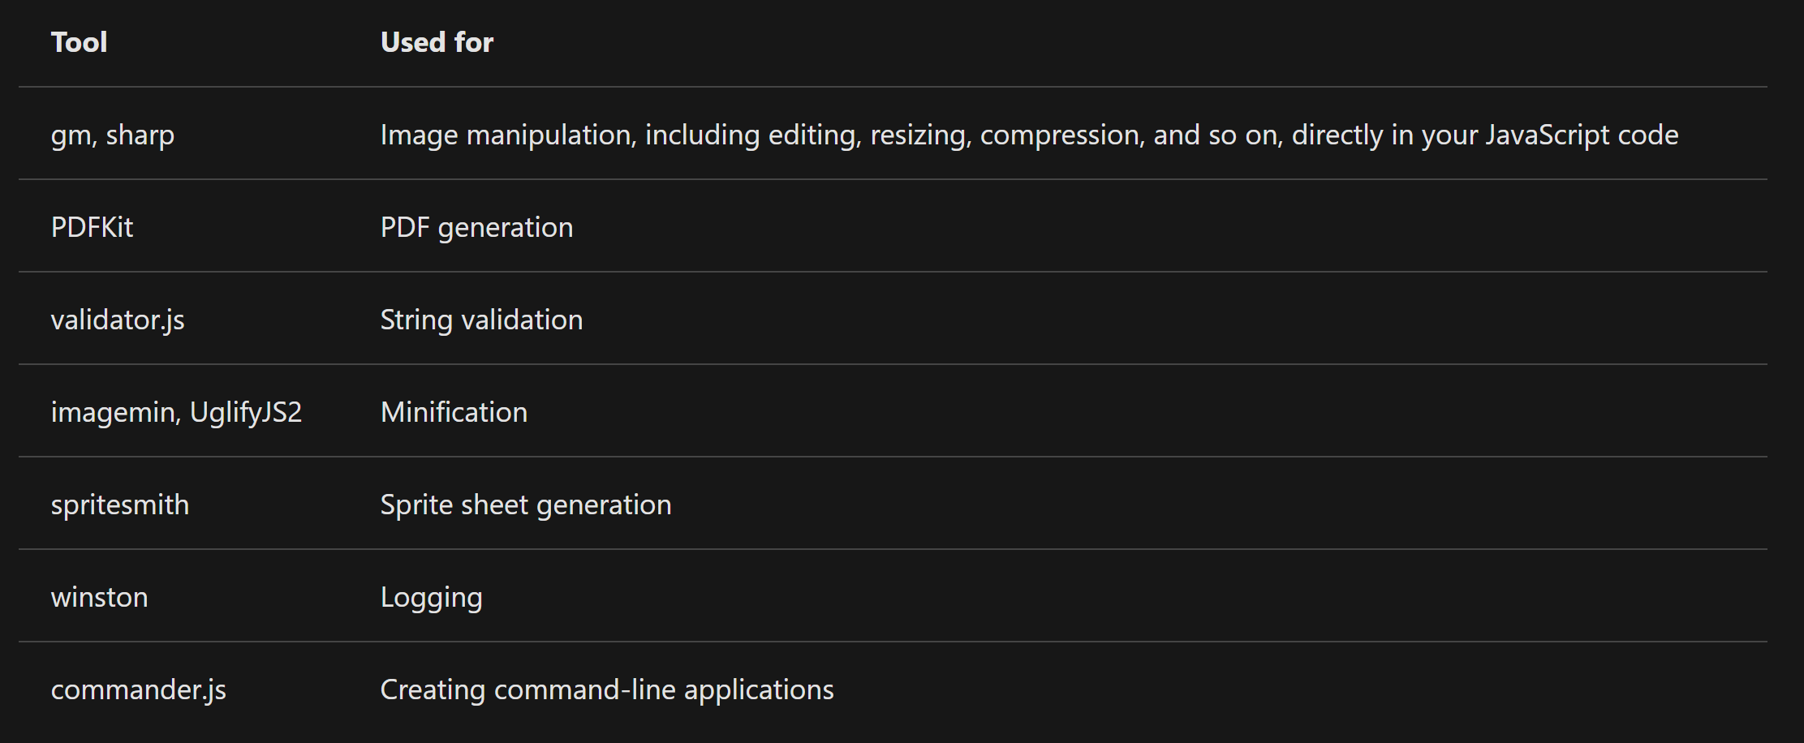
Multiple Node.js Modules Available

Slide 22
Using Node.js
Can be utilized from command-line (interactively)
Can be utilized with other tools to stand up full, runnable web app
Use express <app name> --view=<view engine> to scaffold

Slide 23
WSL & Visual Studio Code

Slide 24
Installing VS Code et al
Use https://code.visualstudio.com/ to install (or search for download)
If not already installed, use https://git-scm.com/download/win to install Git
Can also use sudo apt-get install git to install git in the Linux shell

Slide 25
Install WSL Extension
In VS Code, search for and install the “Remote – WSL” extension
Enables VS Code editor in context of WSL
Provides support for optimal developer experience
VS Code allows setting of default terminal to “WSL Bash”

Slide 26
Debugging in VS Code
Create a debugger config file at launch.json
Debug | Configure feature will create in a .vscode folder in root
Set breakpoints & step through code using “Launch Program” under Debug

Slide 27
Knowledge Check

Slide 28
Summary

Slide 29
What Did We Cover?
Enabling WSL and installing Linux distribution
Windows & Linux file system integration
Creating a website with Node.js in WSL
Setting up VS Code with integration to WSL
Debugging in VS Code

Slide 30
Next Steps
https://aka.ms/WindowsSSLinux-8
https://docs.microsoft.com/en-us/windows/wsl/install-win10
https://daily.dev/blog/5-node-js-express-tutorials-to-go-from-beginner-to-expert

Slide 31

Thank You!
https://www.meetup.com/pro/microsoft-reactor
@MSFTReactor
Q&A
http://www.youtube.com/c/MicrosoftReactor
aka.ms/ReactorEmailSignUp

Slide 32

Please enter the event code 13071 at the start of survey
We are constantly striving to create excellent content and would appreciate if you could take this brief survey.
Survey Link: https://aka.ms/Reactor/Survey

